Slide 1

RMF(Recency, Frequency, Monetary)
Tidyquant Private Limited
Anubhav Anand

Slide 2
Agenda
Introduction
Primary goals
Presentation Title

Slide 3

Introduction
RMF(Recency, Frequency, and Monetary value) Analysis measures how recently, how often, and how much money a customer has given your brand.
Recency
-The freshness of the customer activity, be it purchases or visits.
Frequency
-The frequency of the customer transactions or visits.
Monetary
-The intention of the customer to spend or purchasing power of the customer

Slide 4


Primary goals
who is the best customer?
which of the customer could contribute to the chum rate?
Who has the potential to become valuable customers?
How does rfm help?

Slide 5
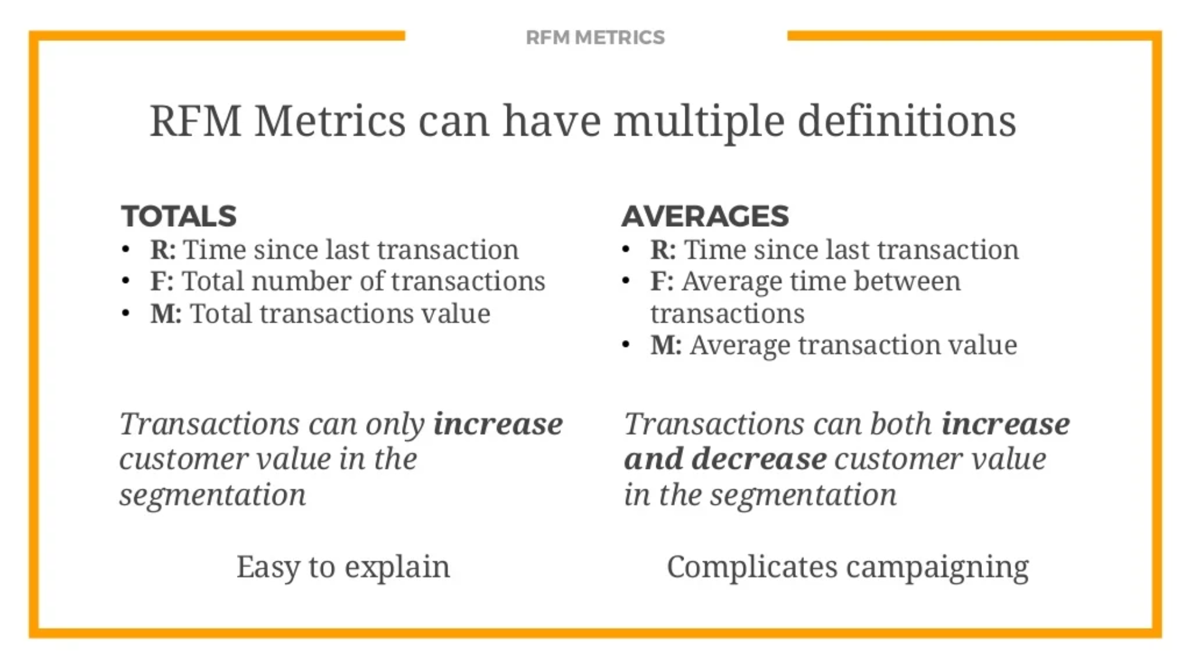

Slide 6
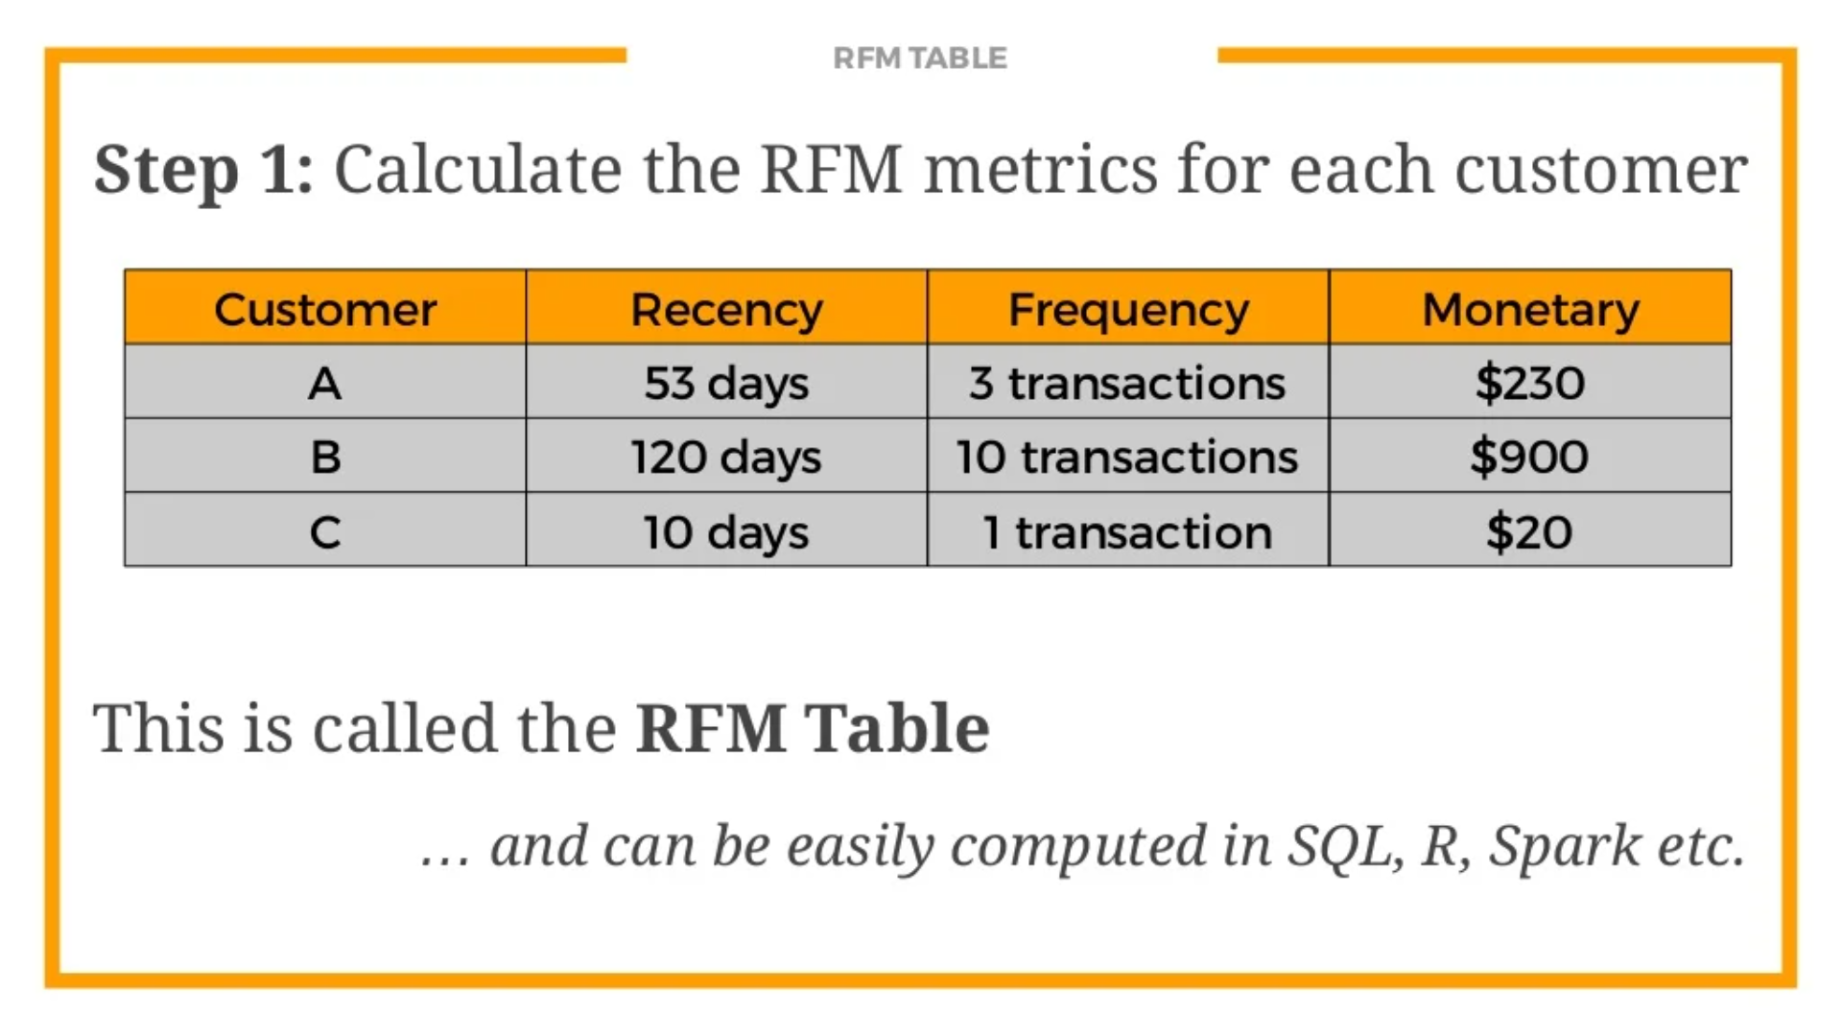

Slide 7
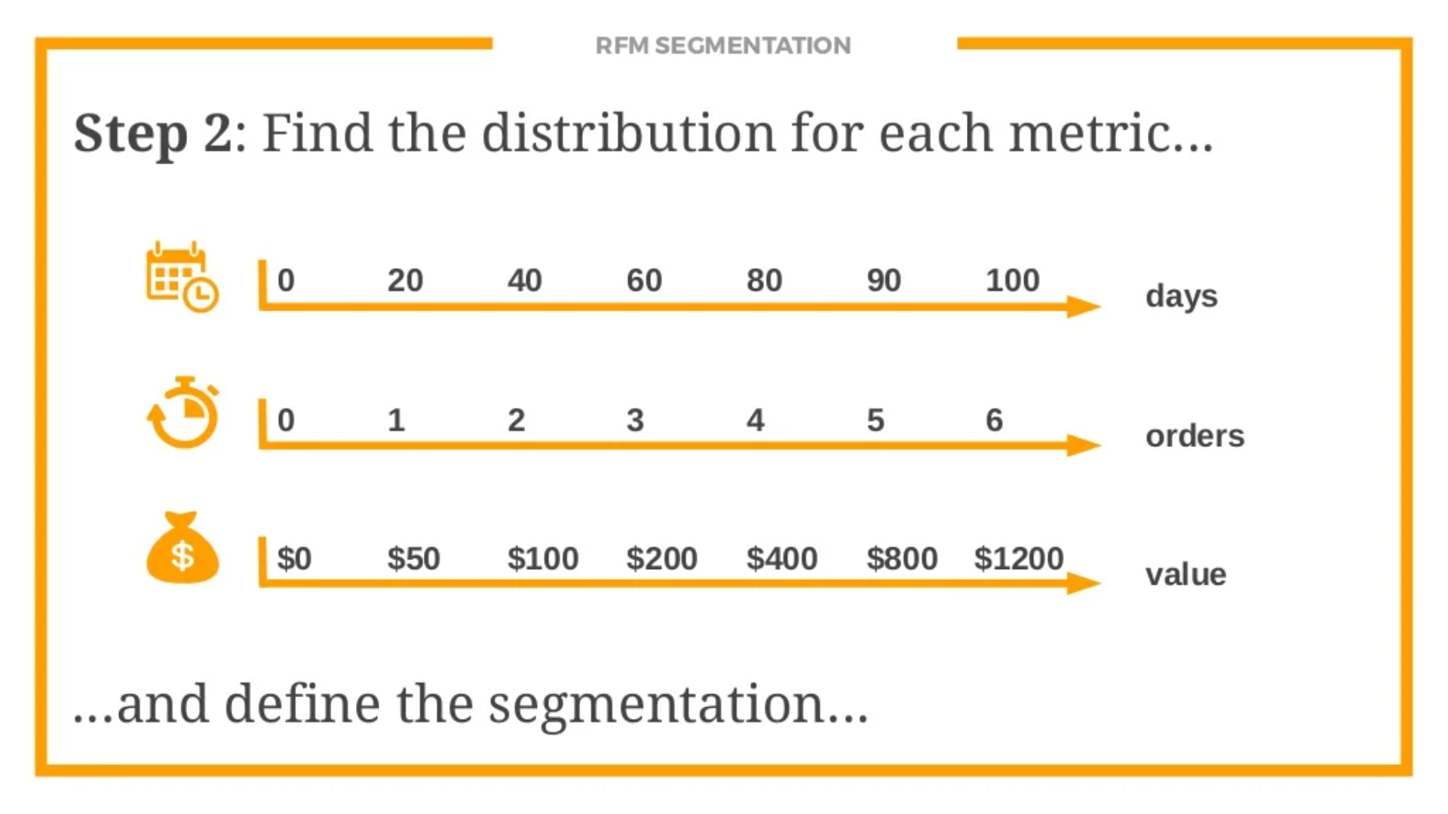

Slide 8
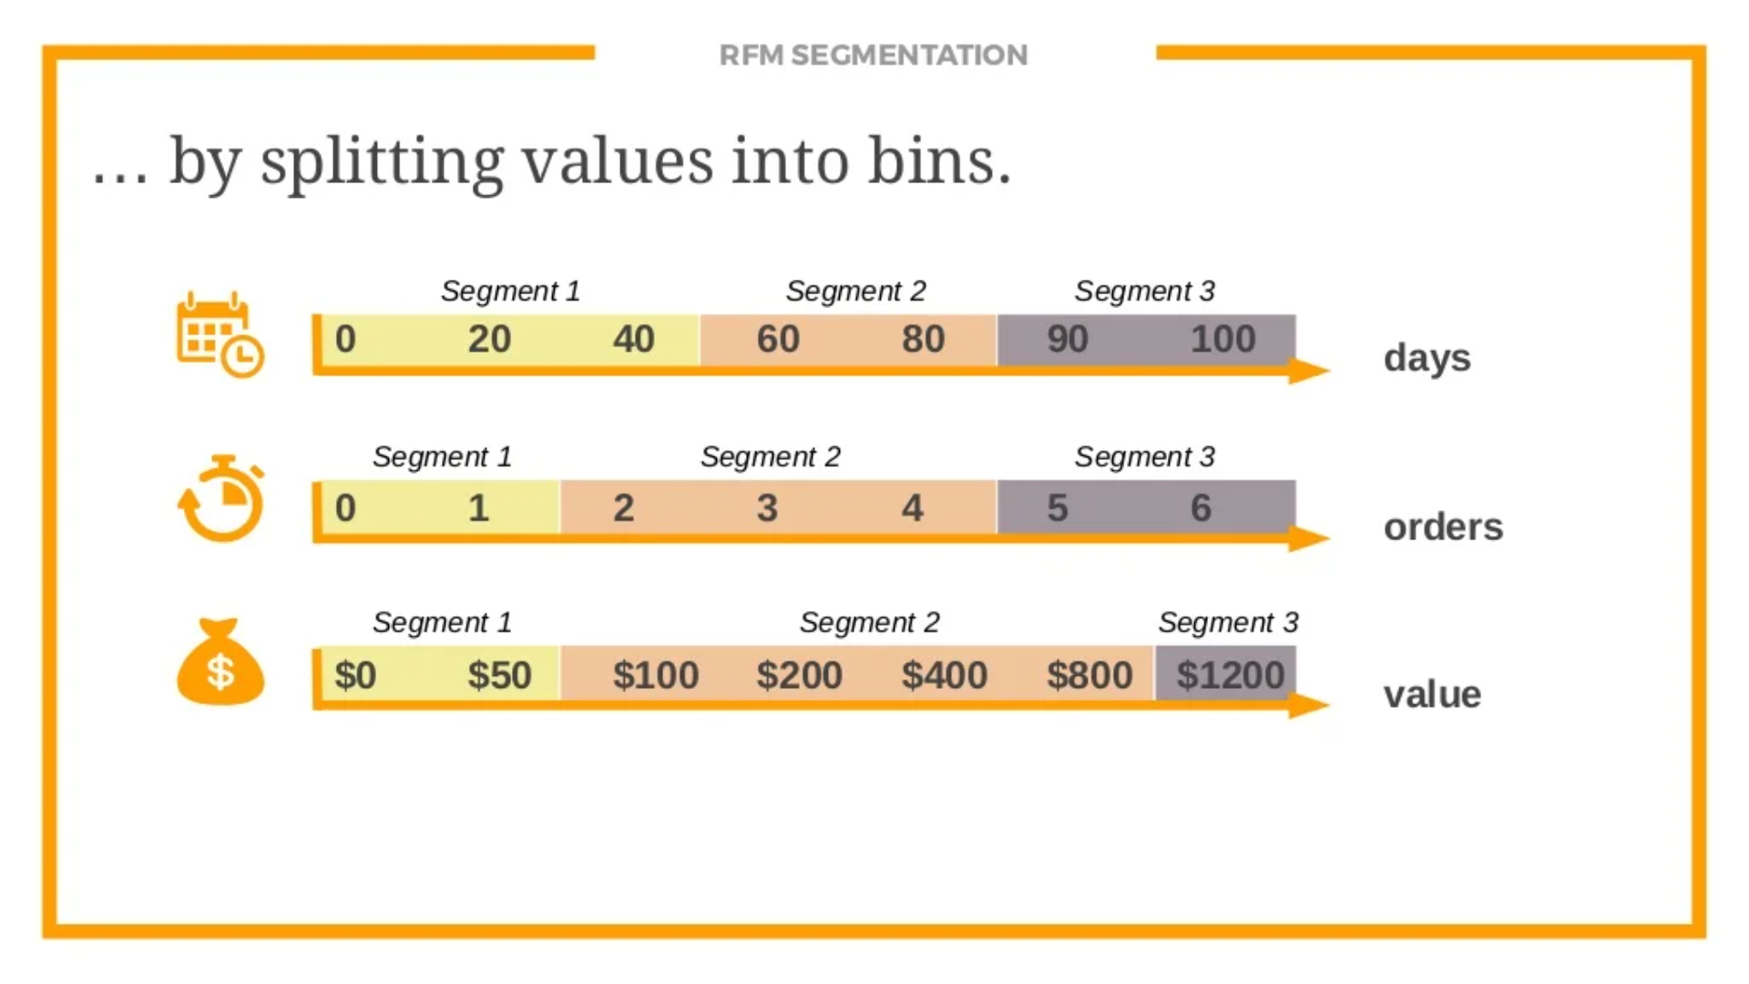

Slide 9
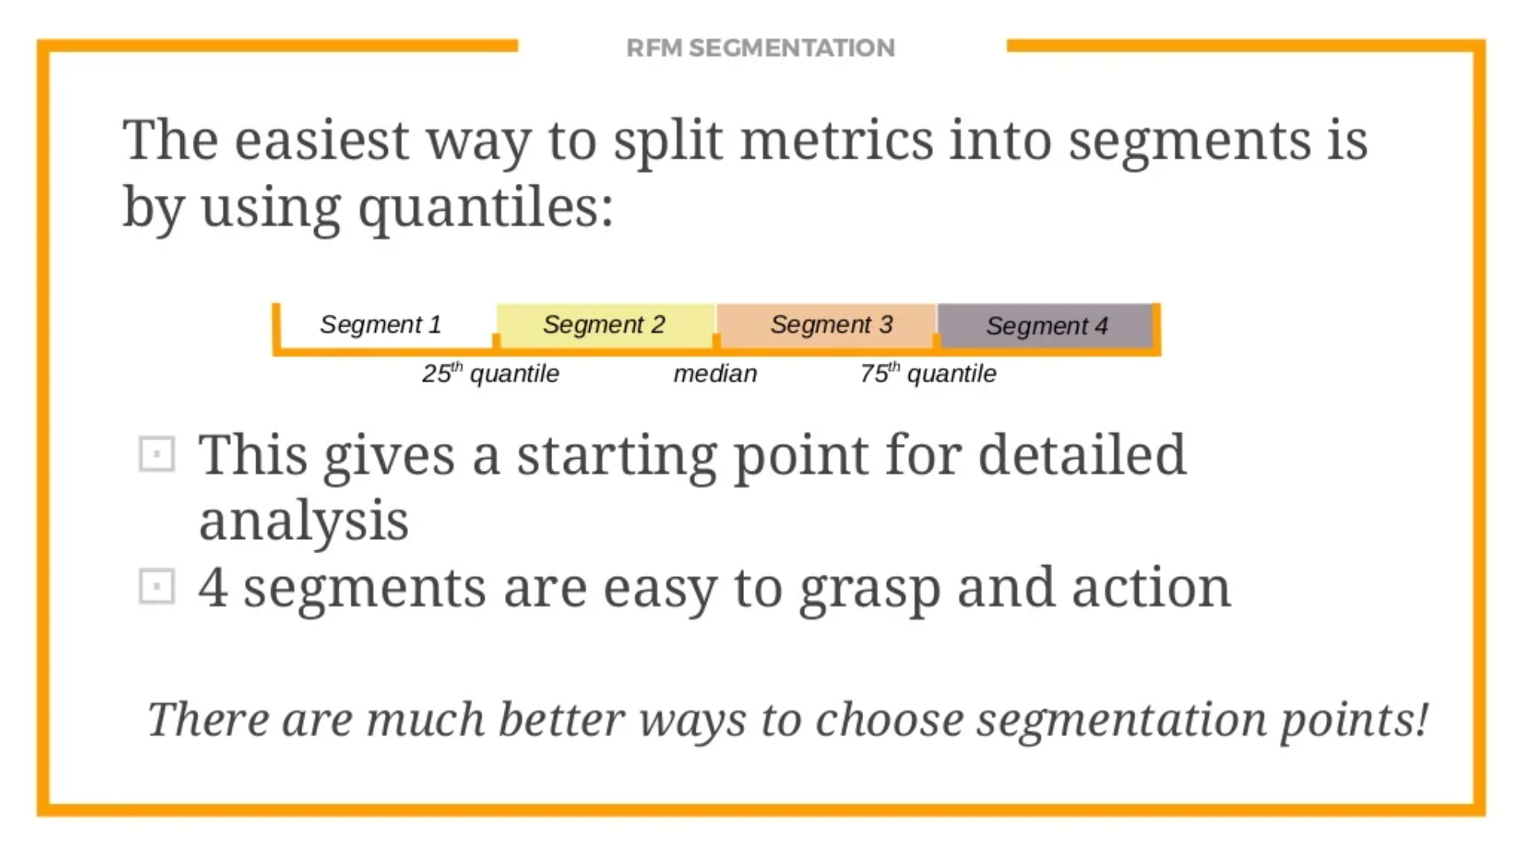

Slide 10
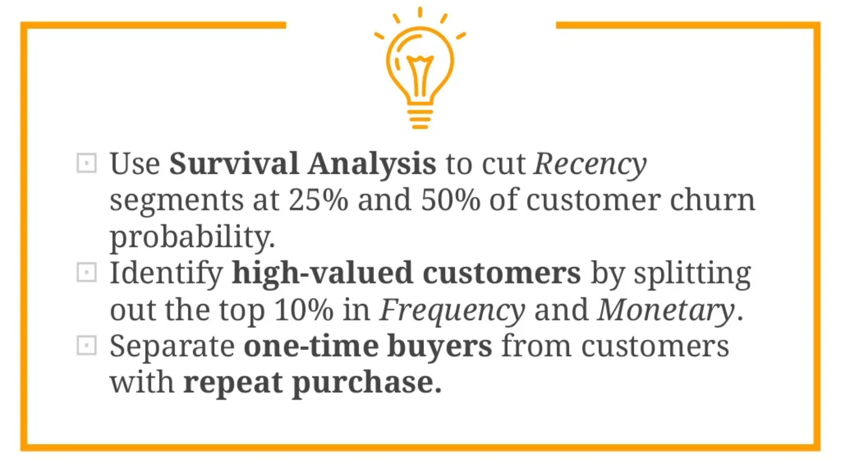

Slide 11
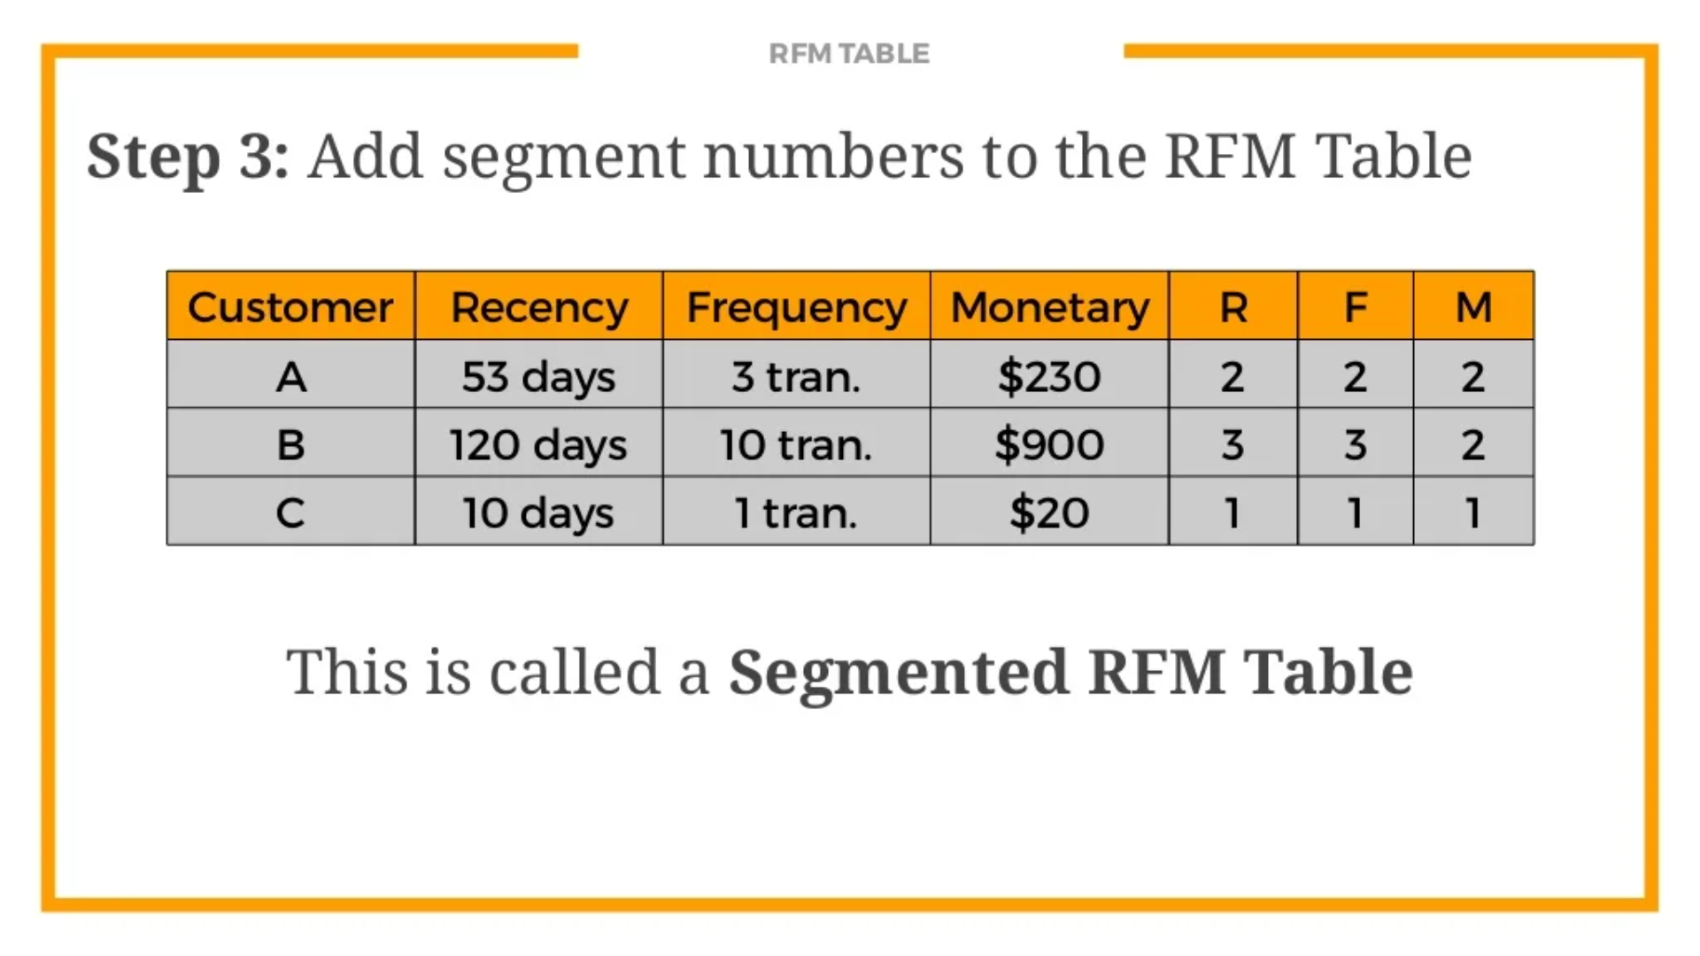

Slide 12
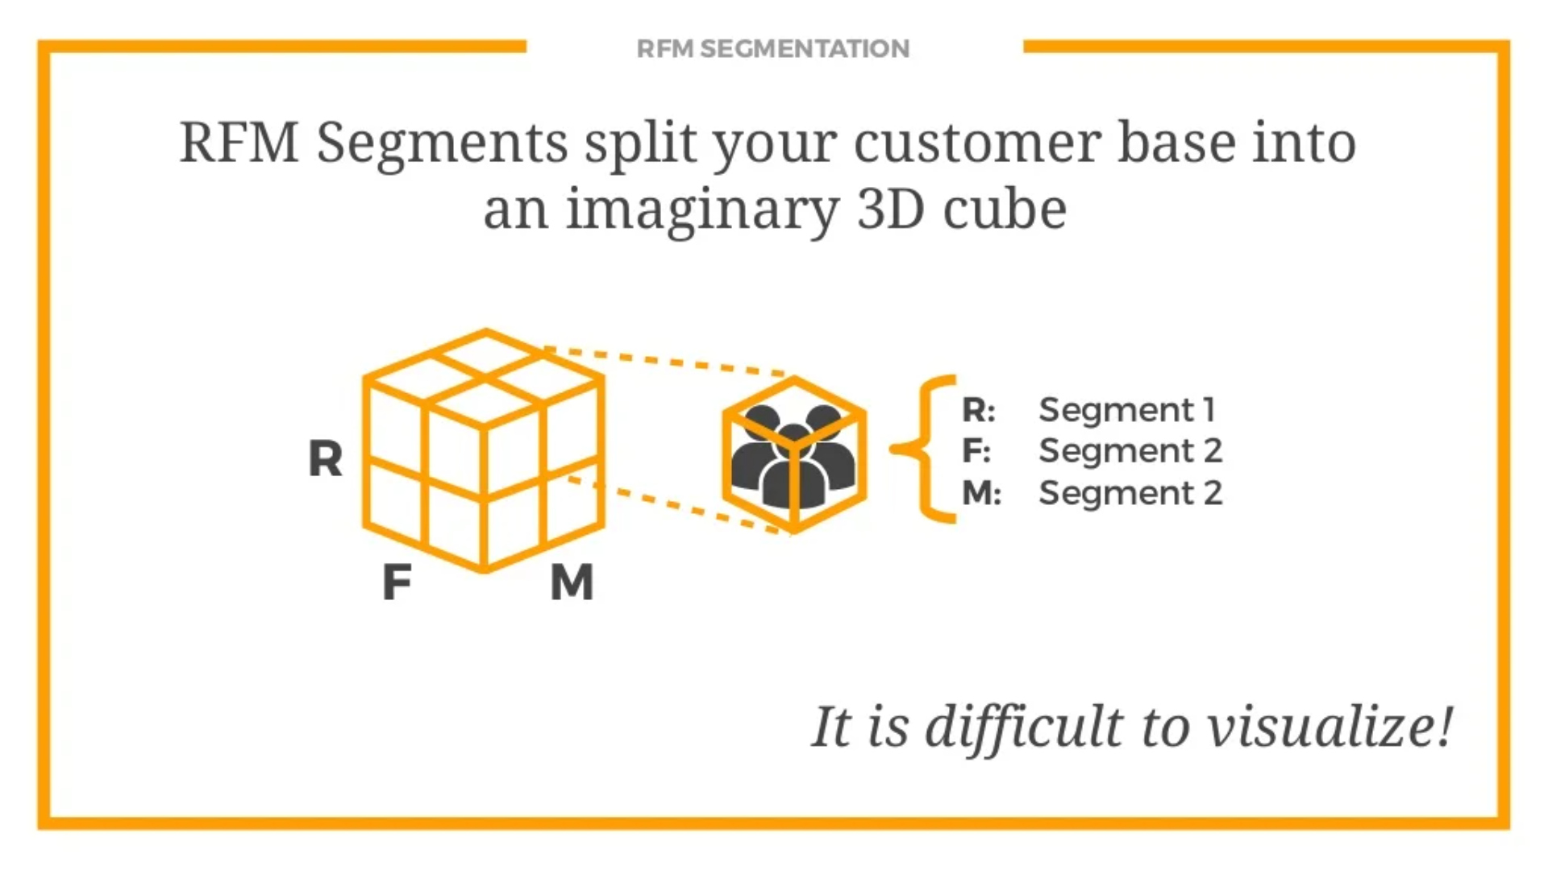

Slide 13
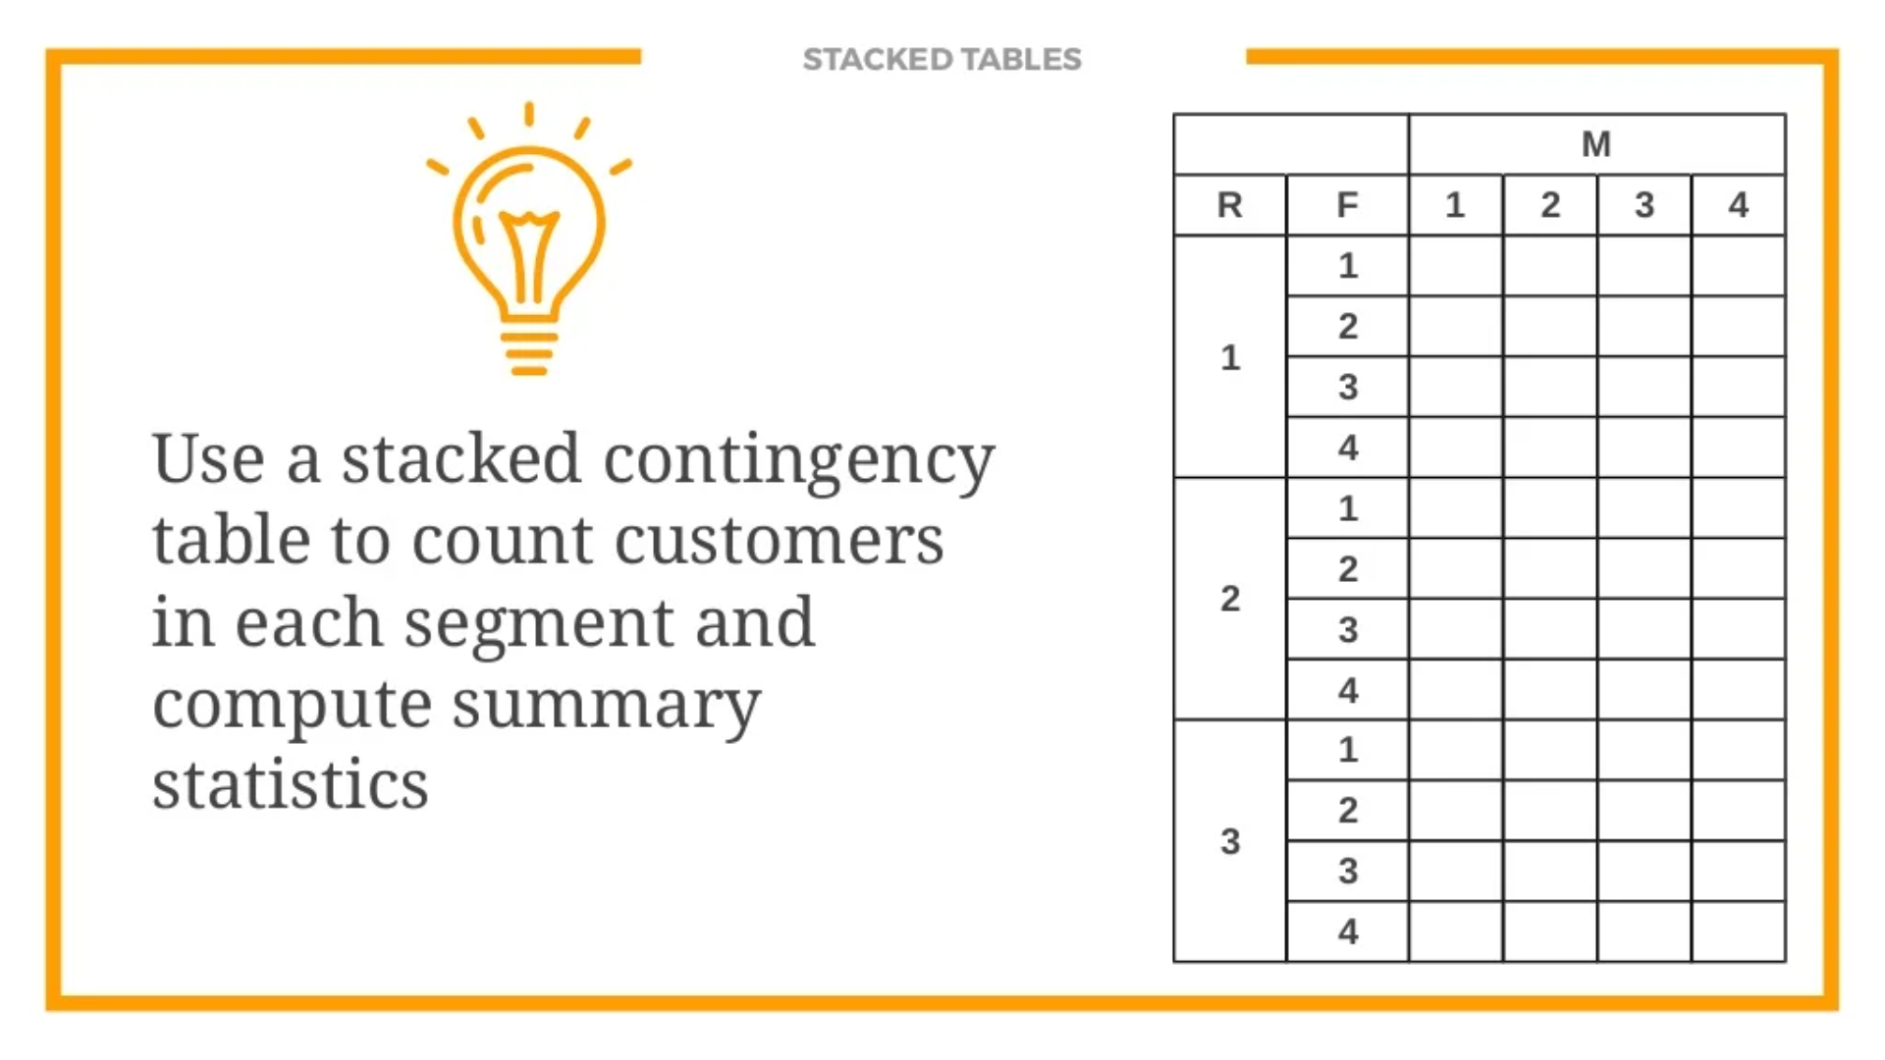

Slide 14
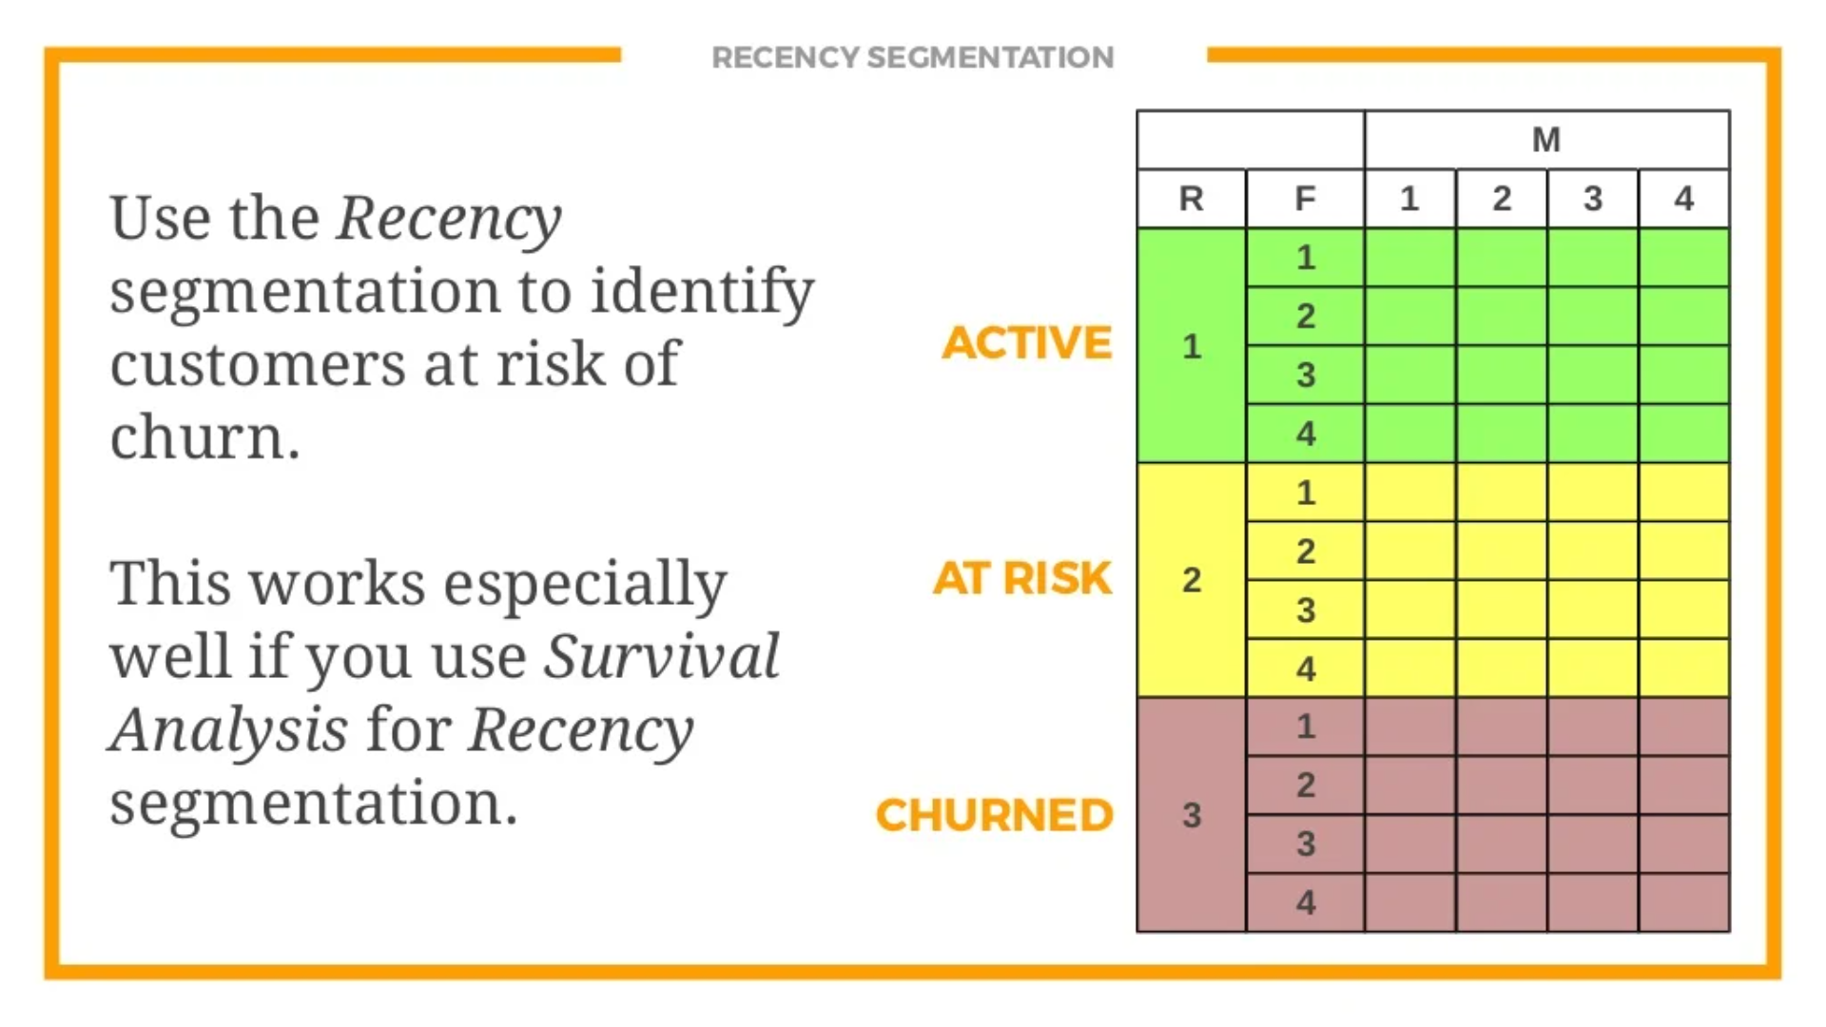

Slide 15
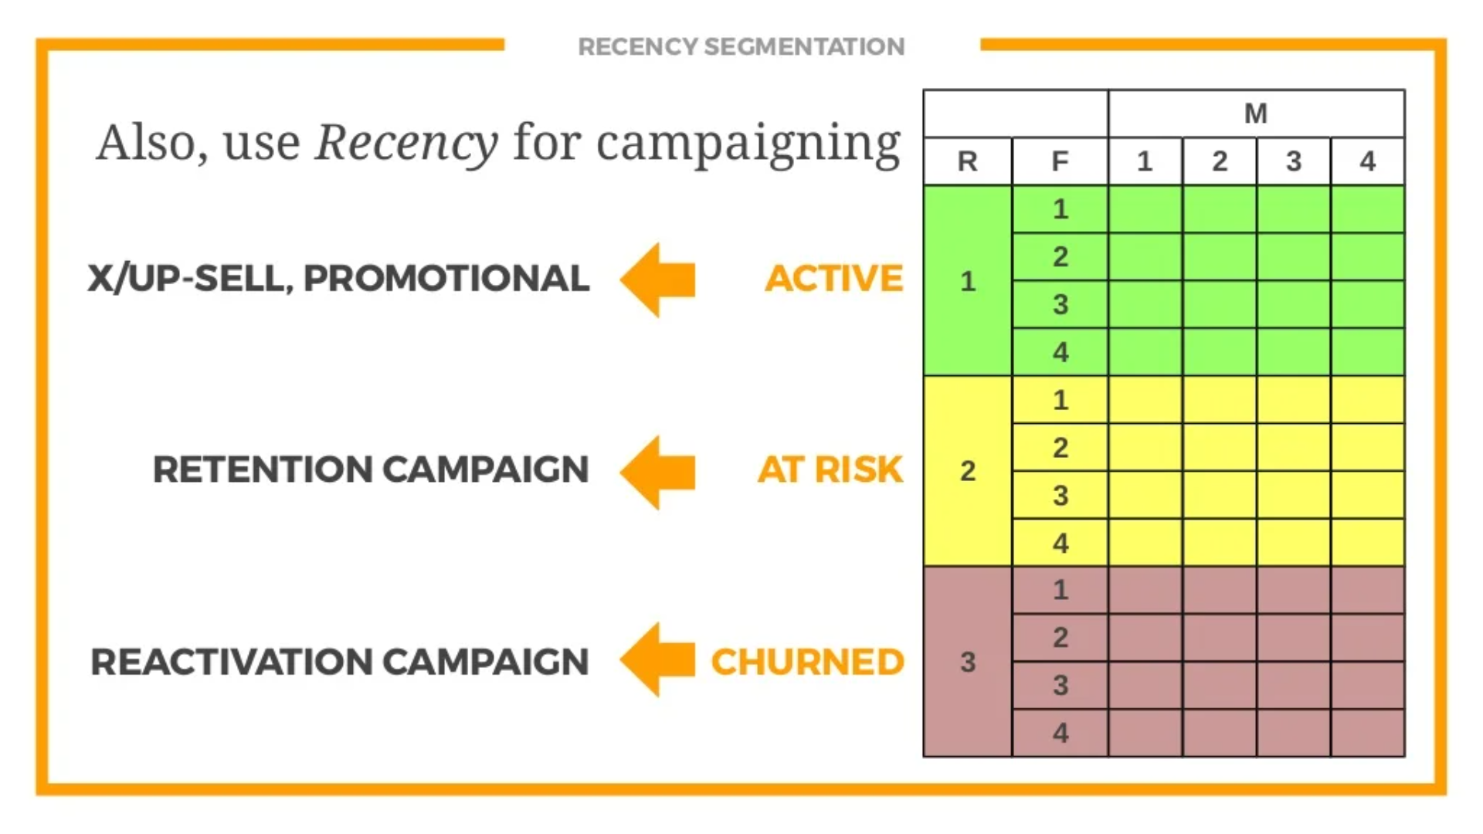

Slide 16
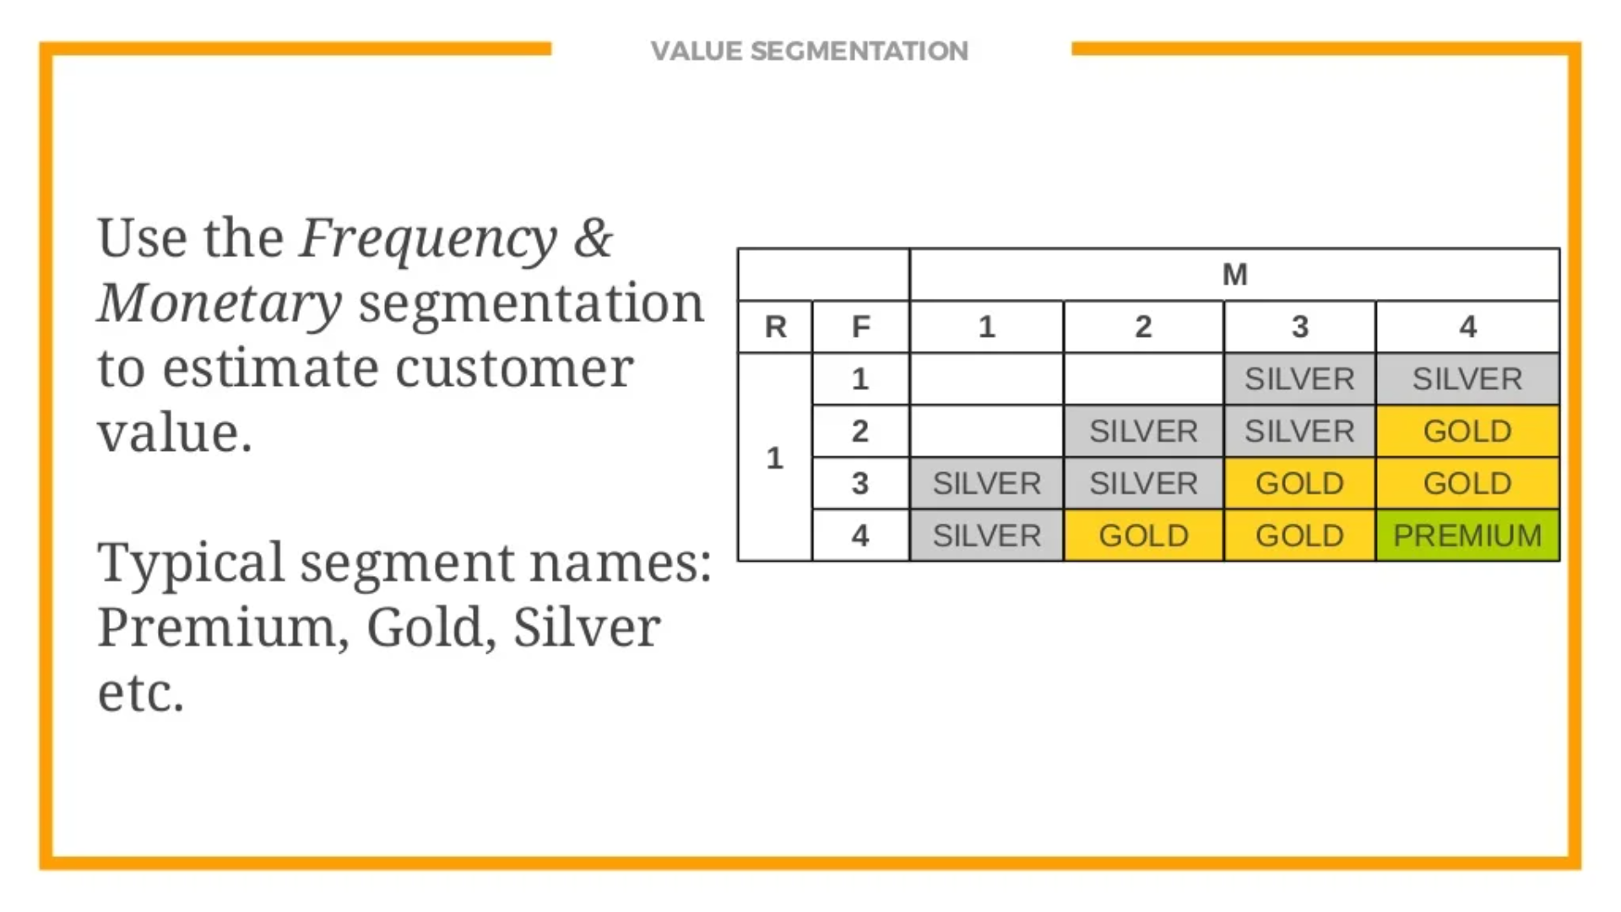

Slide 17
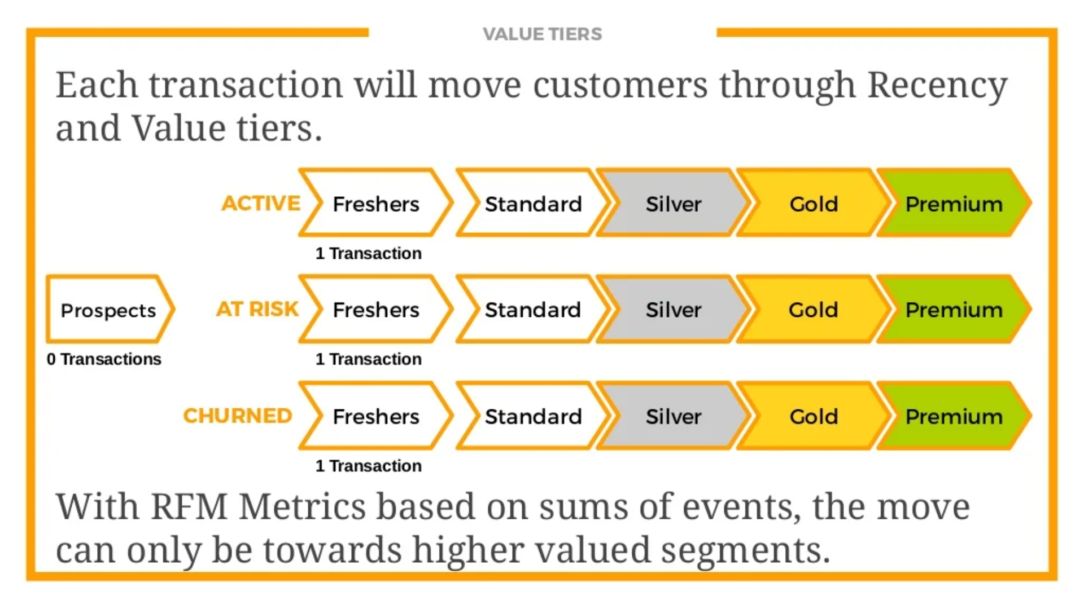

Slide 18
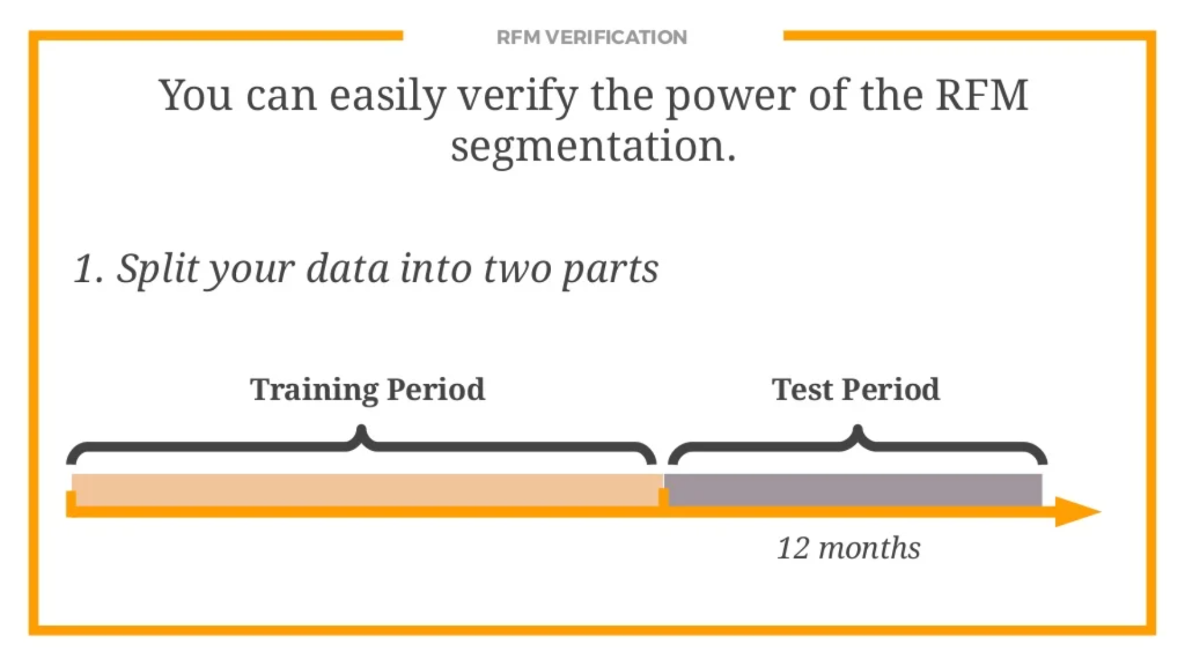

Slide 19
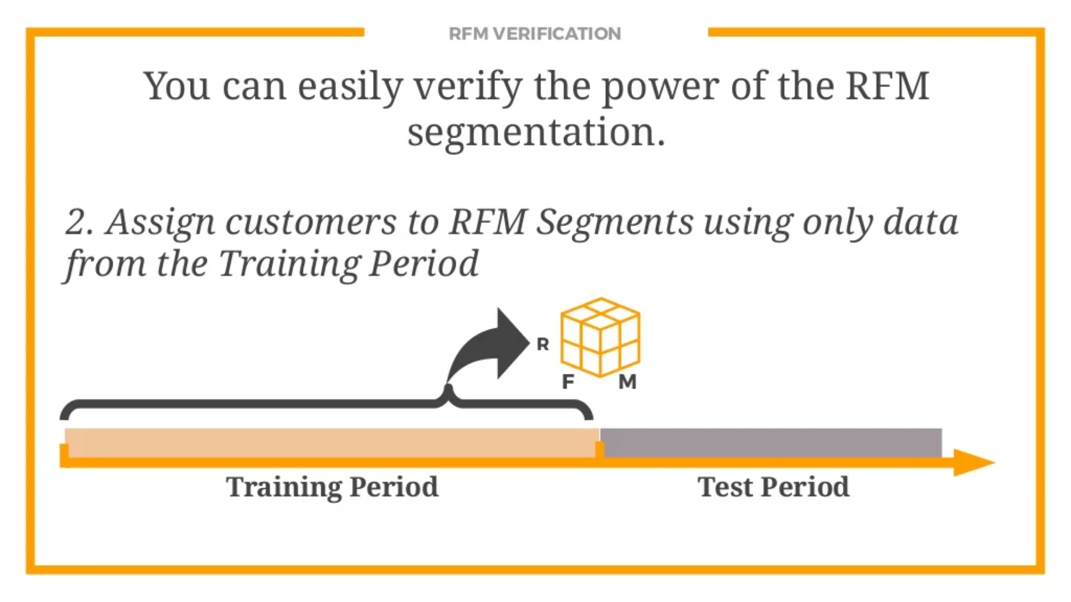

Slide 20
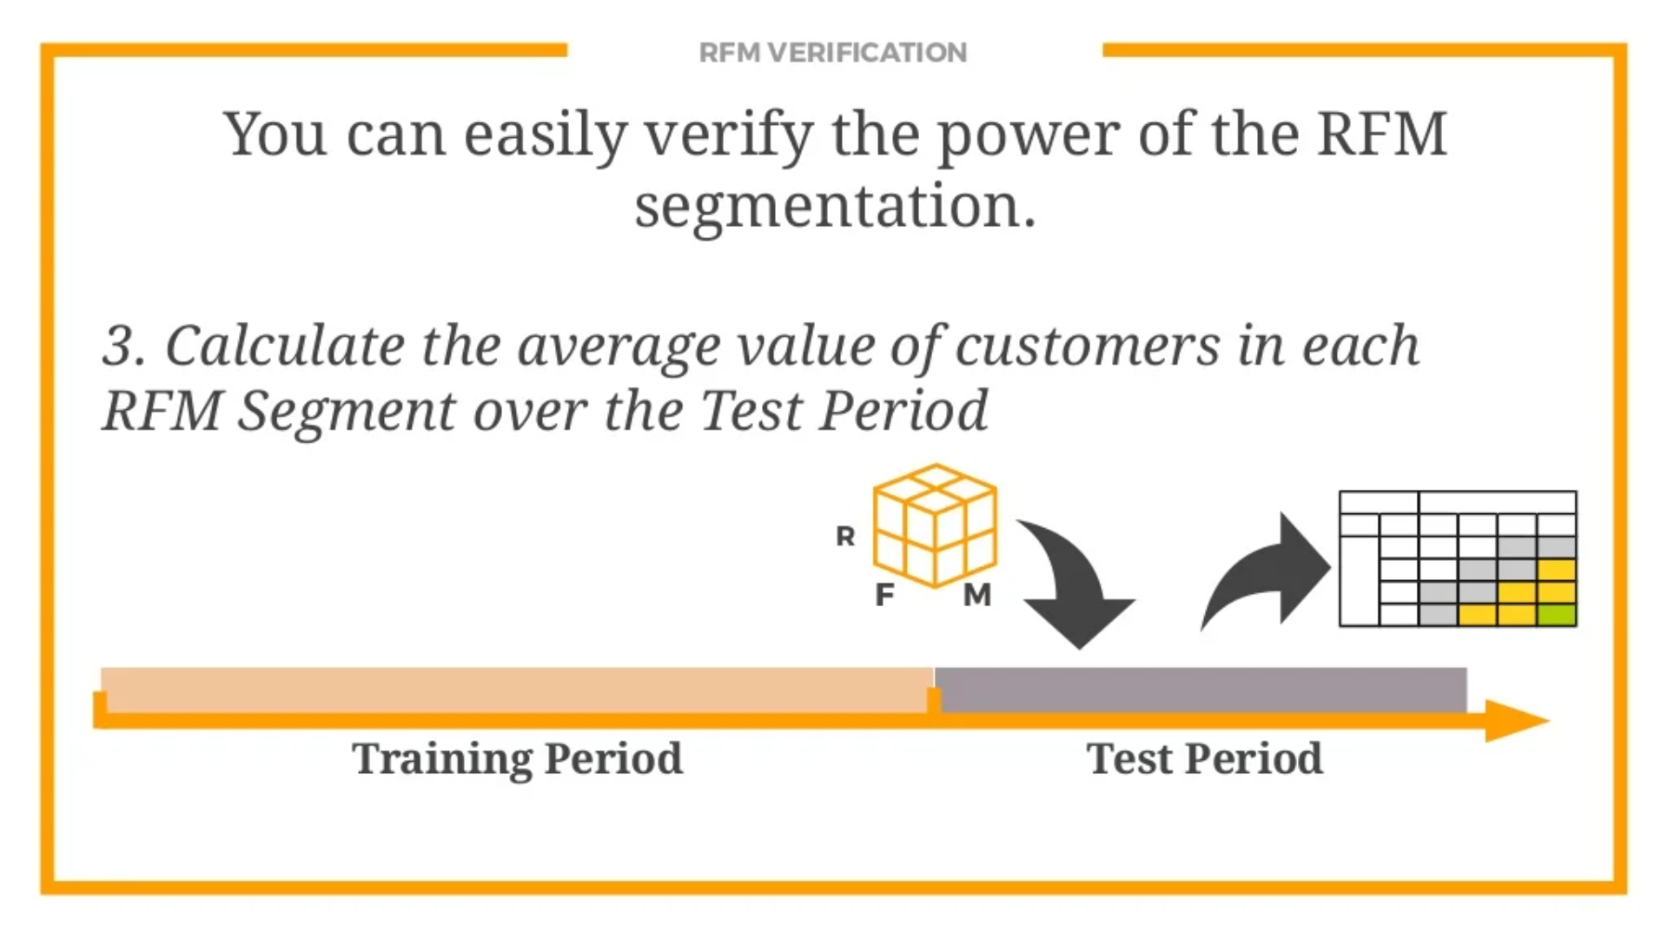

Slide 21
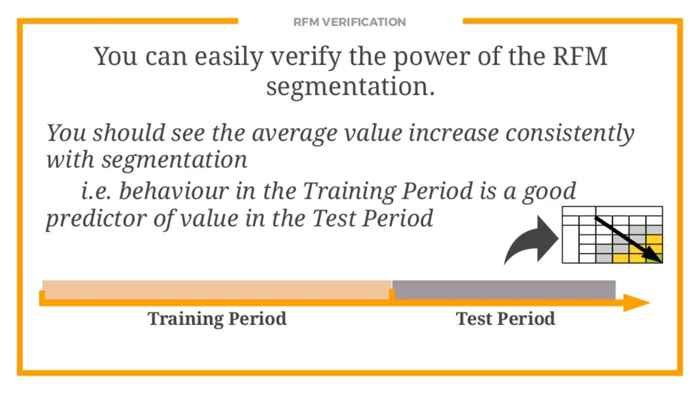

Slide 22

Champions
Champions are the best customers, who bought most recently, most often, and heavy spenders, Reward these customers.
They can become early adopters of new products and will promote your brand

Slide 23
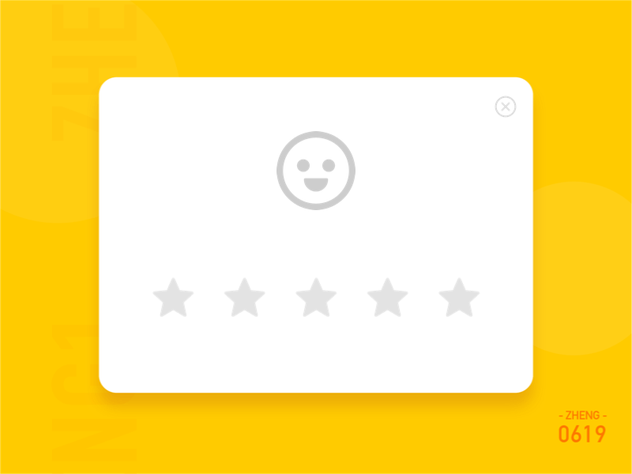
Potential Loyalists
Potential Loyalists are your recent customer with average frequency and who spend a good amount.
Upsell them with memberships, loyalty programs, or recommend the related product to help them become your Champions.

Slide 24

New Customers
New Customers have a high overall RFM score but are not frequent shoppers.
Start building relationships with these customers by providing onboarding support and a fantastic first-time user experience plus a special offer to increase their visits.

Slide 25

At-Risk Customers
At Risk Customers are your customers who purchased often and spent big amounts, but haven’t purchased recently.
Send them personalized reactivation campaigns to reconnect. Offer renewals and helpful products to encourage another purchase.

Slide 26
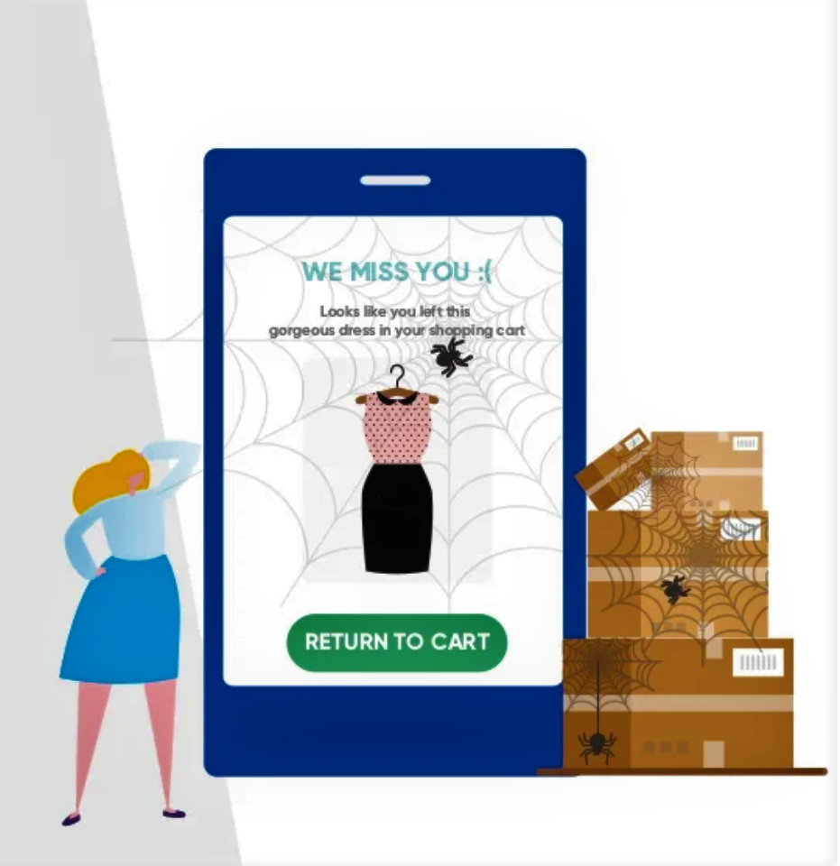
Can’t Lose Them
Can't Lose Them are customers who used to visit and purchase quite often but haven’t been visiting recently.
Bring them back with relevant promotions, win-back campaigns, and surveys to find out what went wrong and avoid losing them to a competitor.

Slide 27

thanks

